Slide 1


ZNSLSM: a LSM-Tree key-value store on Zoned Namespace SSDs
Krijn Doekemeijer
Contact: k.doekemeijer@student.vu.nl
Github: https://github.com/Krien
Supervisor: Animesh Trivedi

Slide 2
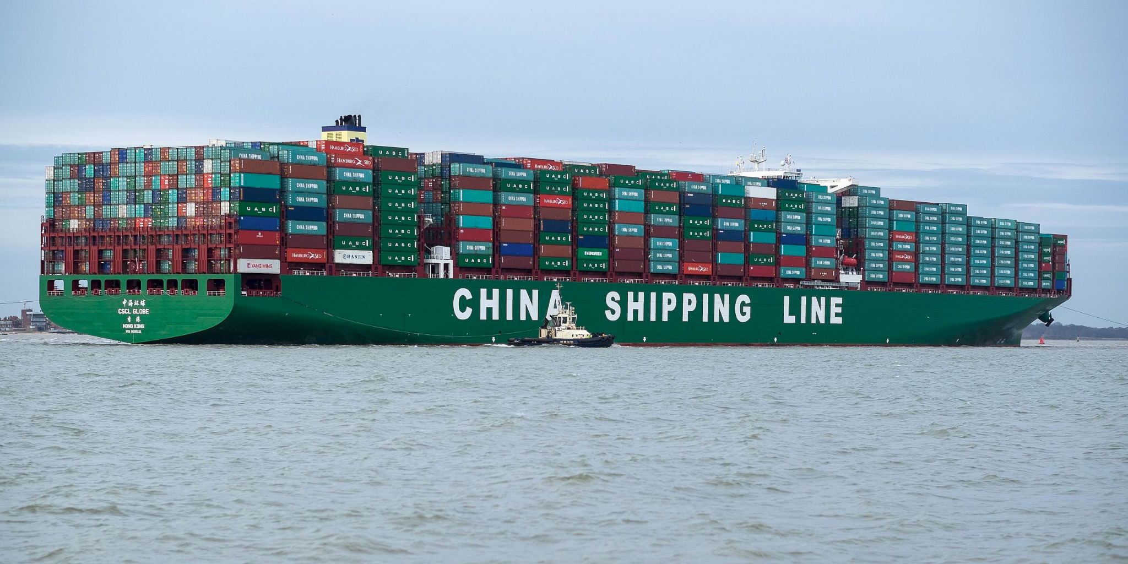
The amount of data is exploding
The world demands more every year:
(2018) IDC expects 175 zettabytes of data by 2025!
Performance requirements increase
A lot of challenges:
How to store the data?
Where to store the data?
How to do it fast, yet green…?
…
Today we will look at one common type of storage: key-value stores + SSDs
https://en.wikipedia.org/wiki/Container_ship#/media/File:CSCL_Globe_arriving_at_Felixstowe,_United_Kingdom.jpg

Slide 3
Database: Key-value stores
A common way to store data
Flexible
Simple abstraction: key -> value
Few operations needed:
Put
Get
Can be optimised for many use-cases
{“ZNSLSM”: “a key-value store for ZNS”}
Store pair
Put pair
{}
{Key:“ZNSLSM”}
Get pair
Look for pair
{}
{“ZNSLSM”: “a key-value store for ZNS”}
Return pair

Slide 4












Who uses key-value stores?
They are used everywhere!
For everything.
Even where it might not be expected… (also MongoRocks, Rocksandra)
+
=
!
Relational database
Key-value store
MyRocks

Slide 5
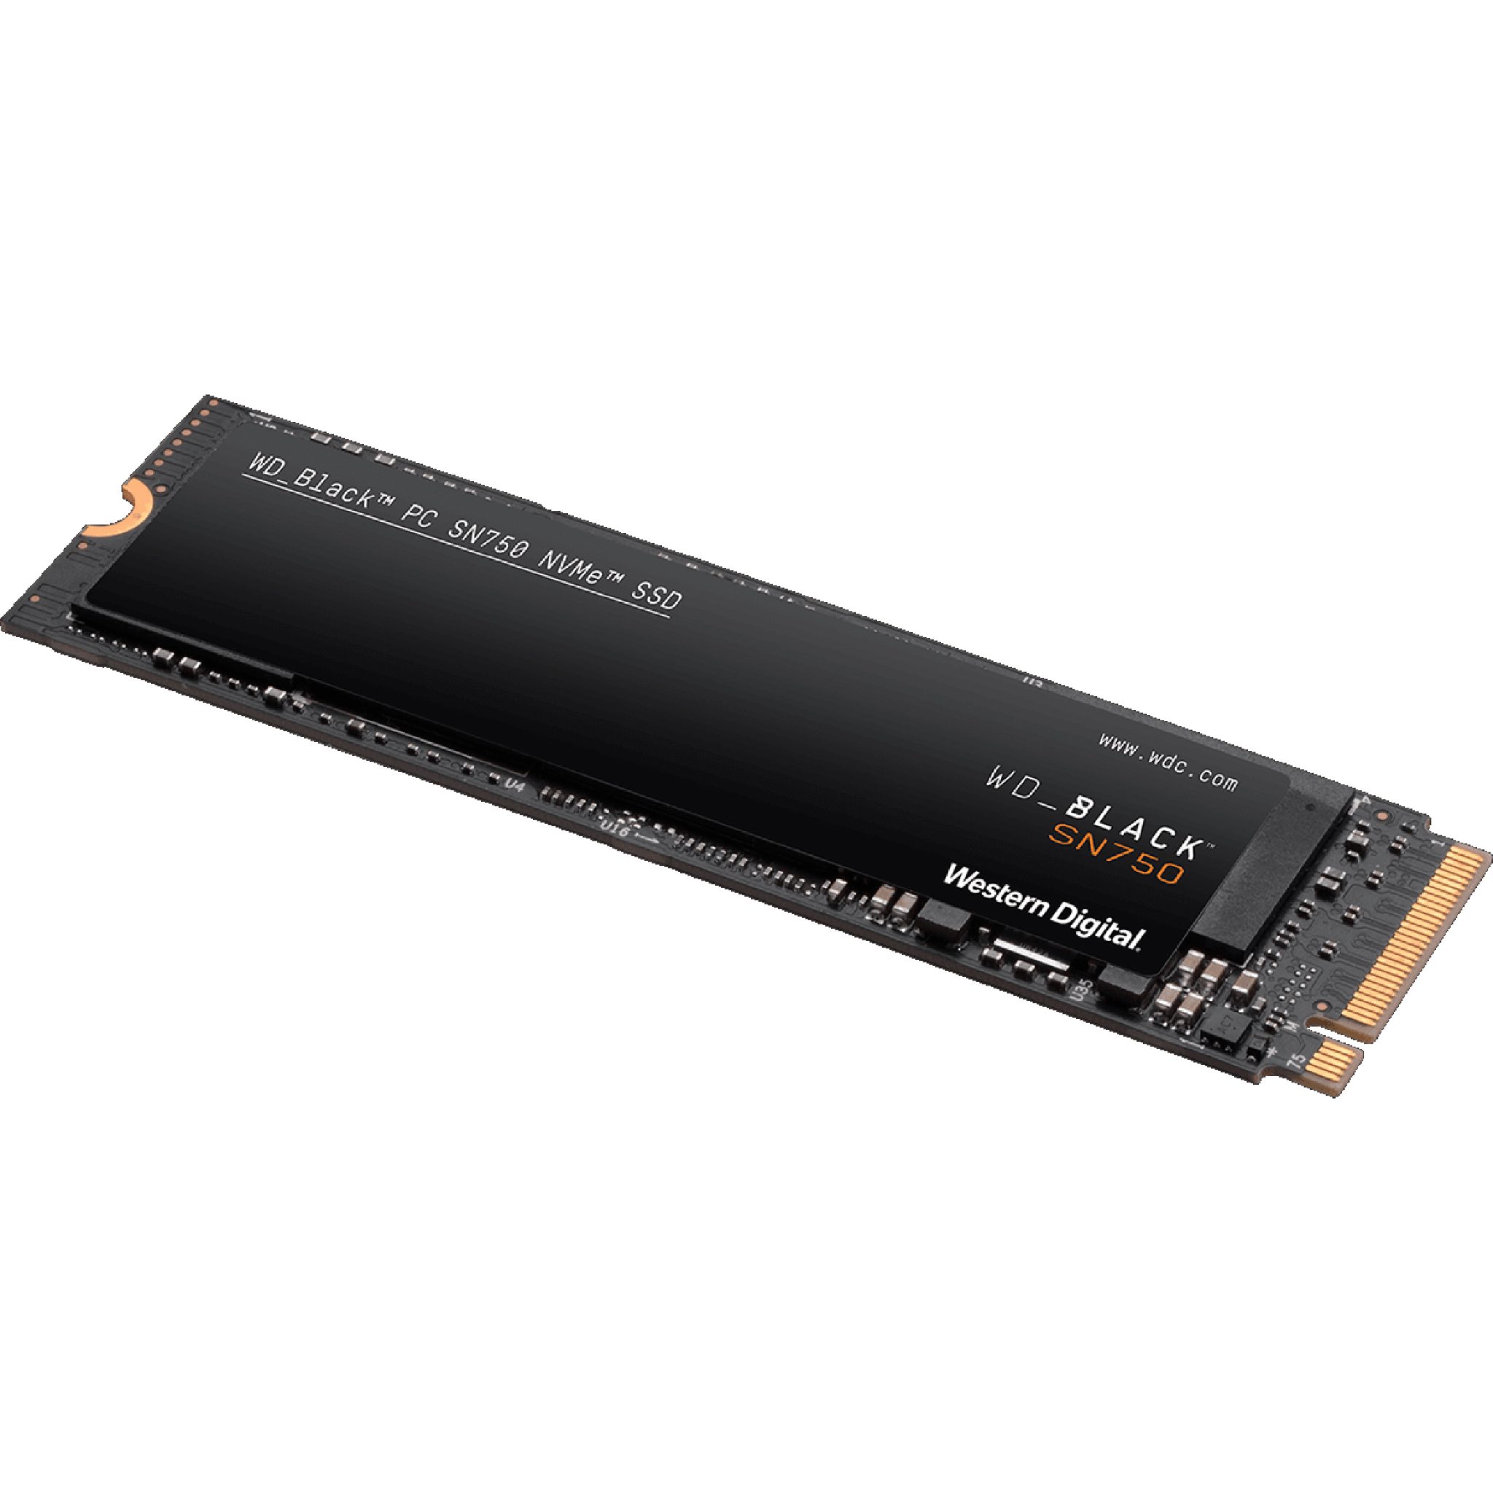
Storage medium: Solid State Drive (SSD)
Why?
Common storage medium 💾
Fast I/O 🗲
Affordable💰
More green than HDDs🍃
How de we use it?
Three types of internal operations:
Read
Expensive write (but no overwrite!)
Even more expensive erase
Divided into “erase blocks”/“zones”, the erasure unit
SSD can be seen as a strip of zones
Zone 1
Zone 2
Zone 3
Zone 4

Slide 6

But how can we overwrite data?
Like transforming “Hello World?” to “Hello World!”
zone 1
zone 2
1 Initial state. two strings stored in zone 1.
“Important data :(” ; “Hello world?”
“Random data”
2 Copy ALL correct data to zone 2
“Important data :(” ; “Hello world?”
“Random data”;“Important data :(”
3 Alter Hello World in memory and write correct to zone 2.
“Important data :(” ; “Hello world?”
“Random data”;“Important data :(”;“Hello world!”
4 Wipe ENTIRE old zone for reuse. It was dirty.
“Random data”;“Important data :(”;“Hello world!”

Slide 7
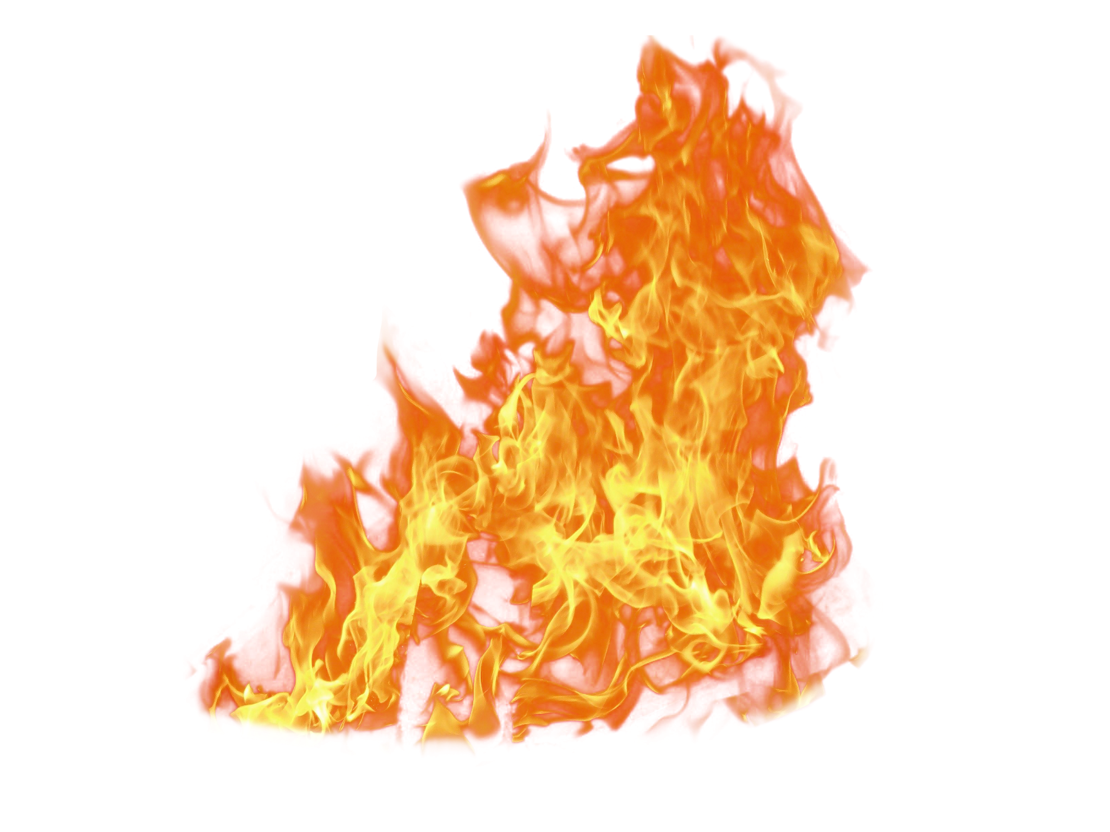
Problem: Wear leveling
I/O physically harms the device
Zones can die…
So using the storage costs 💰
We must keep I/O to an acceptable minimum!
Overwrites write more than what was requested…
This is known as write amplification and is bad for the SSD!

Slide 8
Meet the Flash Translation Layer (FTL)
Supports simple writes and reads to a flat address space!
Thus supports overwrites on SSD? Great!...
Allows using an SSD like a conventional block device.
Easy to use interface!
Remember “overwrites” are bad for wear leveling…
Vendor specific implementation…
Uses a GC, which is unpredictable…
No control over where data is stored
Host issued ops
FTL
Generic I/O ops
Host
GC ops

Slide 9
Meet Zoned Namespace SSDs
The result of decades of SSD use.
Full control over the SSD!
SSD specific interface that fits SSD internals!
A standard, not vendor specific!
No internal GC, must be managed by Host
Requires rewriting a lot of software…
More complex interface…
ZNS ops
Host

Slide 10
Our research goal
How can ZNS be used to optimise the garbage collection process of a LSM-tree-based key-value store?
How can ZNS be used to reduce the write amplification of LSM-tree garbage collection operations?
How can ZNS be used to reduce the number of erasures needed because of garbage collection operations?
Does directly interfacing with storage help with performance
and its predictability?

Slide 11
What we want: Hot and cold separation
Helps the GC (also our own!)
Separate hot from cold data
Hot entries are overwritten a lot
Cold entries are almost never overwritten
No separation
With separation
Cold
Hot
Cold
Hot
Empty
Empty
Cold
Hot
Empty
Empty
Update Hot :(
Update Hot :)
Dirty
Dirty
Cold
Hot
Cold
Hot
Cold
Dirty
Hot
Empty
2x erasures, 2 entire zones rewritten…
Only 1x erasure, 1 zone rewritten!

Slide 12
Log-structured Merge-trees
GC process
Table is full
Client Put
mem
table
immutable memtable
1
2
Flush
Memory (DRAM)
3
Storage (SSD)
Metadata updates/reads
L𖺀
WAL
4
Compactions
Manifest
L1
…
5
Clear Hot and Cold separation! Fits SSDs naturally!
LN

Slide 13
Proposal: Removing layers
RocksDB + SSD
RocksDB + ZNS
RocksDB + ZenFS
ZNSLSM
Key-value store
Key-value store
Key-value store
Key-value store
Domain specific File system
File system
File system
OS kernel
OS kernel
OS kernel
Host
SSD
FTL
SSD
ZNS SSD
ZNS SSD
ZNS SSD

Slide 14




Approach
Modify the state-of-the art: parts of RocksDB and LevelDB
Do not reinvent the wheel
Copy and reuse benchmarking tool of RocksDB: db_bench
Create all I/O structures ourselves
No filesystem!
Manage the GC process of the store AND I/O.
Get full control of device with: SPDK
Work entirely in user space, no kernel
No layers, no swimming bands
Programming languages: C++ and a little C

Slide 15
ZNSLSM: How do we separate on temperature?
Each DB component gets its own “region”
The device is essentially split on temperature
Each “region” therefore gets its expected “size” beforehand
No multitenancy by design, the device is ours!
No files, each region is designed different
Hot components get hot structures, cold components cold
Imagine the entire SSD as one big strip
Metadata
WAL
L0
L1 … LN

Slide 16

DB parts get unique I/O structures, not generic files
For example, consider a WAL (not necessary to know what it is!)
append-only for client
Generic file support for
appends, random writes/reads,...
Erase-only for GC process
No control on when the file is physically deleted…
Marked for deletion?
No external meta data, just 1 write!
External meta data
structures. 2 writes…
Inode
Data
metadata entry 1
data entry 1
Notes:
Each structure is made for one specialised use case
Allows fitting structure to lifetime specifics
Fits the LSM-tree mentality!
To give an example, the structure known as a WAL:
Is 99% of the time write-only…
Needs to be erased frequently…
It is written to for each update (HOT)…
Append-only
Needs to be written to concurrently…
Is really small…
What structure fits best 🤔
Do we really need all file capabilities…
Instead, why not create something as minimal as this log on the right

Slide 17
How does our zone erasure work?
With a standard file system approach:
Key-value store, “deletes file”. This is just a hint
File system, marks file to be ready to deleted
File system decides if/when it wants to use the dead file and resets parts of the file.
Advantage: requires less work from the database engineers.
Disadvantage: When is the file physically deleted? We can not guarantee latency in this way.
With the ZNSLSM approach:
Key-value store, marks zones as “dirty” and ready for reuse.
Key-value store, decides that it wants to reuse zone for a component and resets zones itself.
Advantage: can tweak reset policy to use case of the key-value store. Update-heavy, read-heavy,...
Main problem: What is a good reset policy to pick?

Slide 18
Benchmarking
We need to force the extreme:
Ensure that the key-value store is tested on actual I/O
We do not want to test other parts of the key-value store
Fill the entire device, forcing the GC to kick in at least once
Cause overwrites! Do mostly updates of key-value pairs. The stuff that GC hates…
Compare with the alternatives!
Normal filesystem: ZNS + F2FS + RocksDB,
Domain specific filesystem: ZNS + ZenFS + RocksDB,
No filesystem: ZNS + ZNSLSM <- ours!
Measure GC effects (as best as we can):
Relates to RQ1: writes
Relates to RQ2: resets
Relates to RQ3: latency stability
We run in order (3TB is available):
db_bench Workload | Finished when?
Fill random | 1 TB of pairs are written
Overwrite | 1 TB of pairs are written
Read while writing | 1 extra hour of I/O has completed

Slide 19
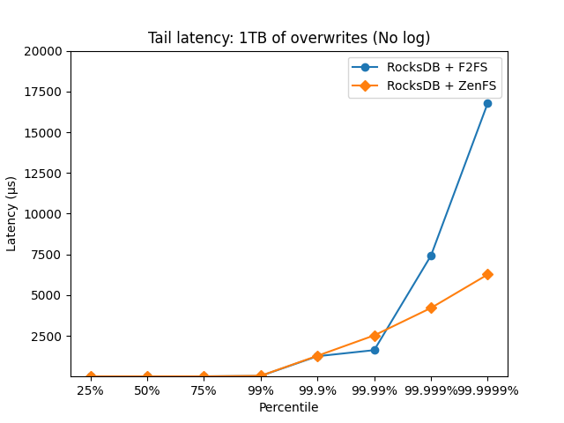
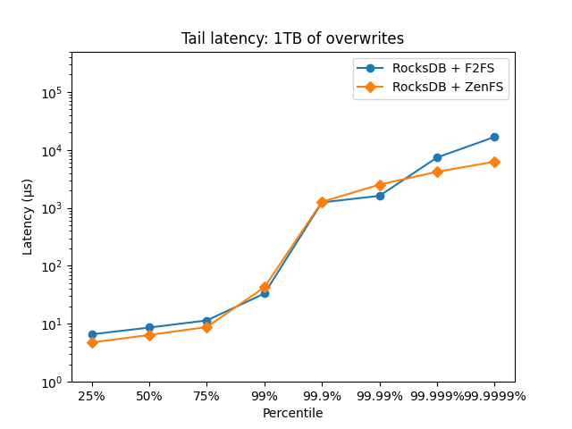
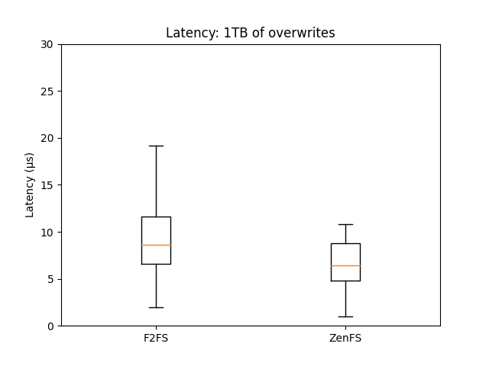
Results: Tail latencies (1TB of overwrites)
IN PROGRESS

Slide 20
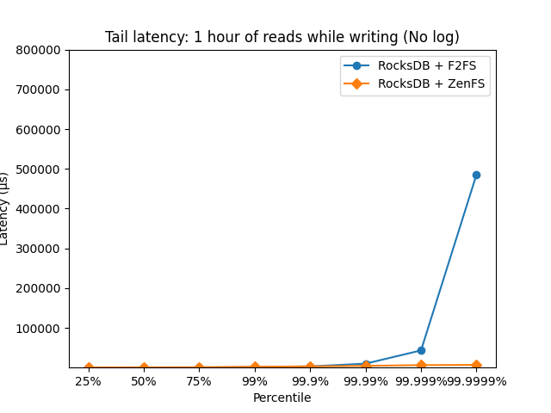
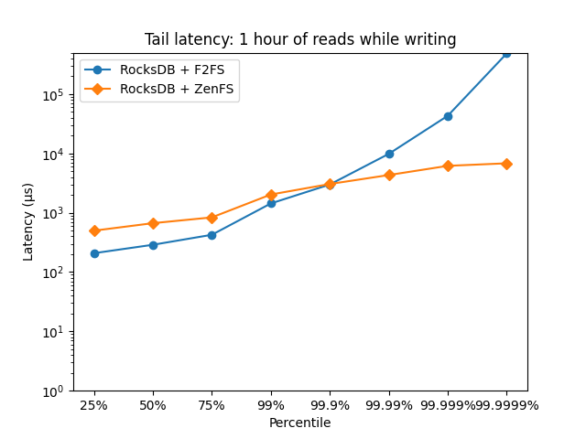
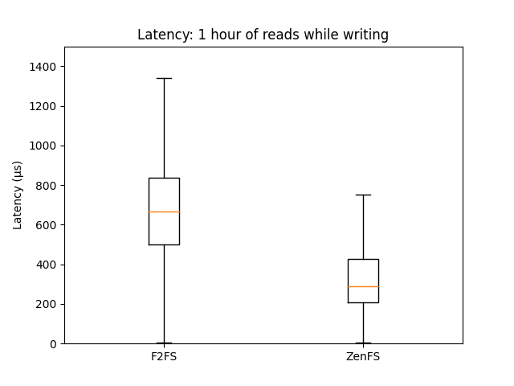
Results: Tail latencies (1 hour of reads during writes)
Acceptable?
IN PROGRESS

Slide 21
Conclusion (for now)
How can ZNS be used to optimise the garbage collection process of a LSM-tree-based key-value store?
How can ZNS be used to reduce the write amplification of LSM-tree garbage collection operations?
We do not have ALL results for this experiment yet. ZenFS has shown to be able to reduce write amplification, therefore we expect similar results. Especially because of proper hot-cold separation.
How can ZNS be used to reduce the number of erasures needed because of garbage collection operations?
We do not have results for this experiment yet. ZenFS mentioned that their design is able to reduce the number of erasures, therefore we expect similar results.
Does directly interfacing with storage help with performance
and its predictability?
Looking at the results of our benchmarks, ZenFS showcases that it achieves more stable latency than when F2FS was used, especially tail latency is more stable. Therefore, directly interfacing with the storage has an effect. An effect that we also expect to see in our design.

Slide 22
Backup slides: How should ZNSLSM be named?
WALs
DB Metadata
Memtable
Memtable
L0
L1 up to LN
…
SSD strip

Slide 23
Related work
As far as we know this is the first direct key-value store on top of ZNS.
Filesystems do exist in some regard:
ZenFS, a file system made specifically for RocksDB and ZNS SSDs.
ZoneFS, is a general file system made for ZNS SSDs. This can also be used on RocksDB. NOT TESTED.
There does exist an LSM-tree for ZNS SSD, but it is made for general GC policies, not for key-value stores.
There exist various works that describe that building a key-value store is viable, such as “Don’t be a Zonehead” by Stavrinos et al., “ZNS: Avoiding the Block Interface Tax for Flash-based SSDs” by Bjørling et al.
Purandara et al. also come with various hints and design decisions for ZNS SSDs, also for key-value stores. This is a good source for design decisions. The paper is “Append is Near: Log-based Data Management on ZNS SSDs”.

Slide 24
Experience of building a key-value store
Work in a lot of places…
New interfaces, require recreating everything yourself
Debug tooling…
CLIs…
Setting up the benchmarking environment is painful
Consistency
Getting modern tooling
Benchmarking, benchmarking, benchmarking…
Running 2 TB benchmarks themselves
Takes days…
Our DB needs to survive a lot! We can not create a simple PoC…
Guaranteeing stability
Persistence?
Deletes?
Persistent deletes!?

Slide 25



What can a key-value store be used for
Used in Gameservices such as Xbox live
Used in distributed databases such as ZippyDB at Meta
Can also be used for caching, Redis, Memcached, Riak…
Can be used with various services such as AWS: DynamoDB
Might scale better than relational databases
Used for graph query engines such as Dragon
For low latency-queries, such as at Netflix.

Slide 26
When to use key-value stores
I refer to my literature study
When latency matters, fast reads and writes
Especially for in-memory key-value stores!
When the consistency model differs
Some key-value stores have a weaker consistency model, this might be all that is needed
Data is highly dynamic, many optional parts of a value “JSON”
Think about rich documents, instead of predefined objects
When it fits simple key-value queries?
We do not always need filters
OLTP is a good use case
Simple, allowing other applications/DBs to add what they want themselves. Minimalism!

Slide 27
ZNS (more detailed explanation)
Can only append to a zone only, so no random writes, but read everywhere
←—------------------ 1 zone
R
R/W
R
However can append to multiple zones (limited to a number of active zones)
<-N zones
Yes
Yes
Yes
Yes

Slide 28
Garbage Collection
Clients
Used by the Flash Translation Layer (FTL) to support overwrites…
Process of managing “garbage”
Removing stale data
Moving data to new locations
The issue:
Write Amplification!
Writing more physical data than logically requested
Remember last example…
Consumes I/O, CPU and memory
typically by a few background threads
Hampers latency of clients
Contention issue
Key-value
store
GC threads

Slide 29
Yet the current situation…
LSM-tree
DB operations
A semantic gap of layers
Easy abstraction, small components, very UNIX-like
but…
Each layer knows little about the next…
No clear separation between hot and cold
Even when LSM assumes there is!
On the picture on the right:
WAL and LN data might be put in the same zone!
Hot files might be put in same zones as cold files!
Manifest
File
LN
Files
WAL File
Most LSM knowledge lost…
File system
Most File knowledge lost…
FTL
SSD

Slide 30
Versus
A generic file:
Explicit locking
Writes and reads need to be supported
Random writes?
Needs to support large files, more metadata
Complex metadata updates
Considered hot nor cold :(
…
A specialised WAL structure:
No locking for reads
Only appends
No metadata updates
Only need to support small sizes
Only stored together with other HOT WALs

Slide 31
Designing WALs
What do we know about a WAL?
Only “used” for redos on restart
During an active session it is write-only
Order does not matter
WALs are small
Design:
X small WAL regions of each Y zones
Clients write
GC erases old WALs
Parallel writes with append (async)
WAL
Append-only for client
Erase-only for GC

Slide 32
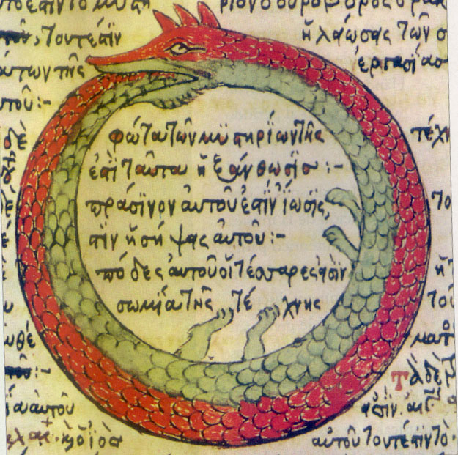
Designing of L0
L0 properties:
Essentially an append-only queue
Clients only read
GC writes to head and erases from tail
Data is never rewritten!
Design:
Circular log like an Ouroboros
Data is written to head and erased from tail
Data is read from the body
The head wraps around
Tail
Head
https://en.wikipedia.org/wiki/Ouroboros#/media/File:Serpiente_alquimica.jpg

Slide 33
Designing LN
Free zone seeker
LN properties:
Written to infrequently
Large tables
Tables need to be overwritten/merged
Fragmented log:
Each table, its own zones (no unnecessary resets)
As tables are large, unused data should be little…
Metadata of zone collections is stored separately
Read from collection, write to collection and reset collection
Zone1, table3
Zone1, free
Zone3, table1

Slide 34
Final design
WALs
DB Metadata
Memtable
Memtable
L0
L1 up to LN
…
SSD strip

Slide 35
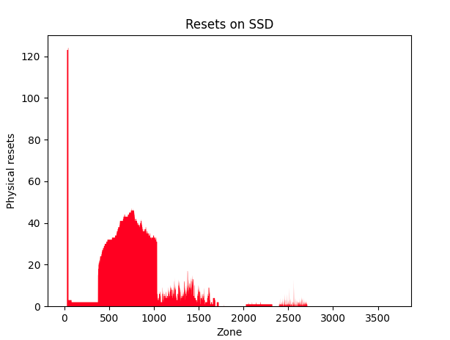
Results: Zone metrics
WAL
L1
Our design is a PoC, but we can immediately see the issue here…
It is ok to separate on Hotness, but if a structure is too hot, it will burn up the SSD in one spot.
WALs NEED to rotate
LN should even out, not stay in the beginning.
Solution:
Add L1 .. LN and WAL to same handout routine of zones.

Slide 36
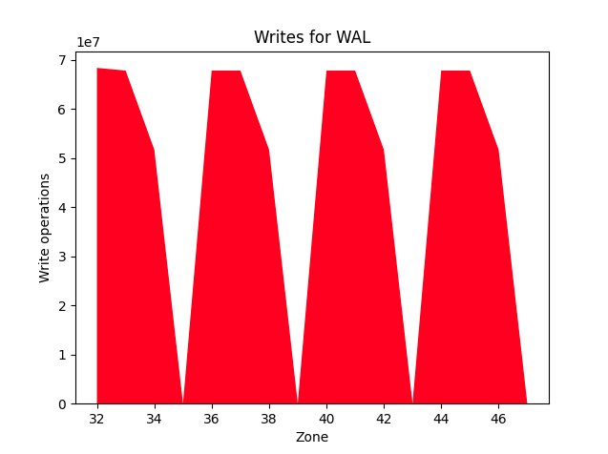
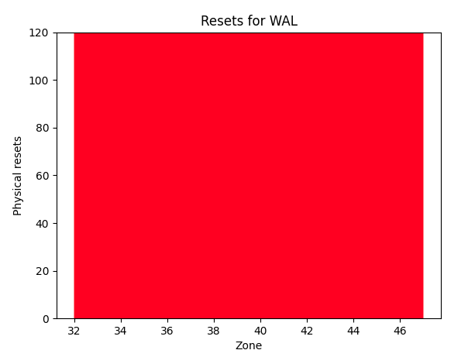
Raw metrics: Diagnostics
WALS are filled up very soon.
Why?
See picture on right
WALS are also very slow…
Why?
Only 3 concurrent writes…
Thus every 4th write needs syncing.
3 asyncs are too little compared to what the memtable can satisfy
Solution: increase async to > 3
???

Slide 37
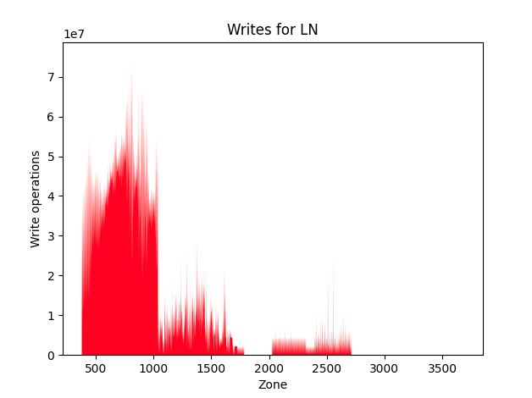
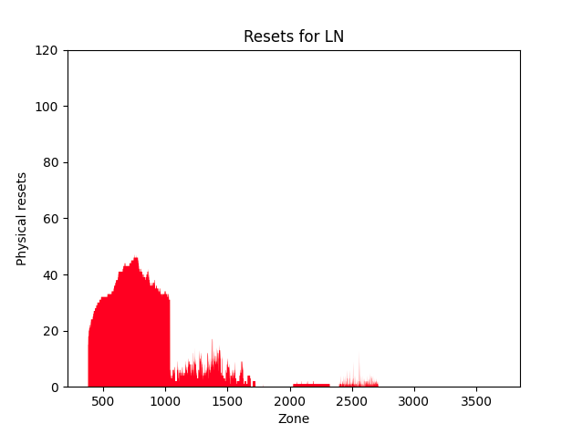
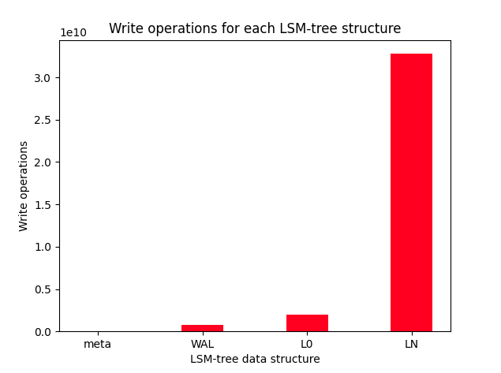
LN is a real problem
Unacceptable
Not properly used (gaps)

Slide 38
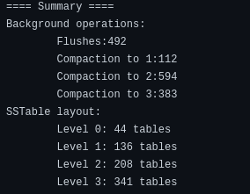
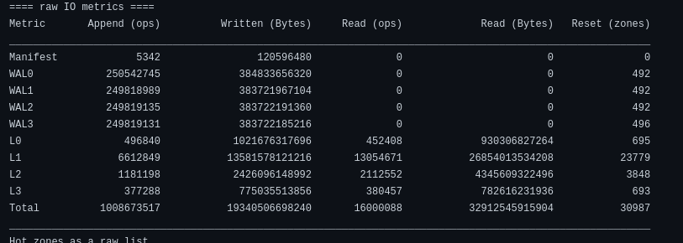
LN is a real problem 2
SSTable size on LN is smaller on LN than on L0???
L1 is almost ALL I/O!

Slide 39
Solution
Increase LN table size. Must be bigger than L0 and must be big enough to not require too much merges.
Do not separate L1 from LN, use same space. Allows data to remain in the same zones :).
Compaction to separate thread from flushes. Compaction is too expensive.

